Slide 1
Chapter 5
Textures, Sprites, and Fonts

Slide 2
This Chapter
What is textures, why textures
How to map and control
Addressing efficiency: loading and memory
Faking animation with textures
Displaying fonts (text) with textures
This is our text solution

Slide 3


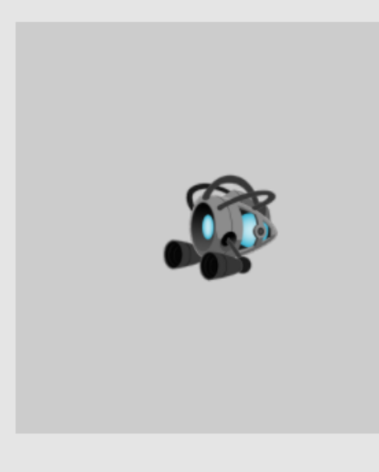
Texture Mapping
A Texture: Fancy word for “an image”
Texture Mapping:
Fancy word for pasting an “image” on a geometry
Texel: pixels of a texture
WARNING: for WebGL (and many hardware)
Texture resolution must be of powers of 2
E.g., 16 x 32, or 2 x 512, or 512x512
1023x1025: is a BAD resolution for WebGL

Slide 4
Why Texture Mapping
Represent “objects”
Cheap, easy, with high quality
Typically: specifically drawn by artists
Ease of control/manipulate
We know how to control a geometry
Control of “objects” can be simply
modifying the corresponding transform (Renderable!)

Slide 5

Texture Mapping Considerations
Texture external to the engine:
Loading must occur
When to load, what happens when done?
Textures with Transparency
The Alpha channel
File format: jpg and png
Memory concerns (lots of textures)
Size of image file (texture)
Sharing of the same texture

Slide 6
A Word about “Transparency” or Alpha
Color = [R, G, B, A] (e.g., [1, 0, 0, 1] for red)
A: the Alpha Channel
Typically for Alpha Blending
Colors C1 = [R1, G1, B1, A1], C2 = [R2, G2, B2, A2]
Blending the colors:
Result = C1 * A1 + C2 * (1 – A1) ←This is the default WebGL blending
Or
Result = C1 * (1 – A1) + C2 * A1

Slide 7
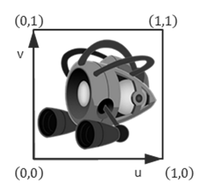
How to texture map?
Map: from one coordinate system to another!
Texture Coordinate System (UV Coordinate)
Just as NDC and WC, independent of pixel (or texel resolution)
Constant range
0 < U < 1
0 < V < 1
Always cover the entire texture

Slide 8
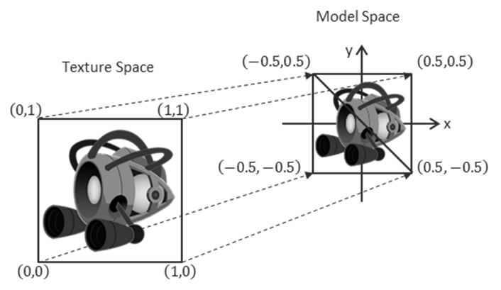
Mapping UV to the Model
Texture mapping:
Associate UV positions with corresponding geometric positions
Define UV values at vertices in Model Space!!
Communicate this association to the WebGL

Slide 9
Question: What will I see
My object:
V1: Position=(-0.5,-0.5) UV=(0, 0)
V2: Position=(-0.5, 0.5) UV=(0, 1)
V3: Position=(0.5,0.5) UV=(1, 1)
V4: Position=(0.5, -0.5) UV=(1, 0)

Slide 10
Answer: What will I see
My object:
V1: Position=(-0.5,-0.5) UV=(0, 0)
V2: Position=(-0.5, 0.5) UV=(0, 1)
V3: Position=(0.5,0.5) UV=(1, 1)
V4: Position=(0.5, -0.5) UV=(1, 0)

Slide 11
Question: What about now?
My object:
V1: Position=(-0.5,-0.5) UV=(0, 0)
V2: Position=(-0.5, 0.5) UV=(0, 0.5)
V3: Position=(0.5,0.5) UV=(0.5, 0.5)
V4: Position=(0.5, -0.5) UV=(0.5, 0)

Slide 12
Answer: What about now?
My object:
V1: Position=(-0.5,-0.5) UV=(0, 0)
V2: Position=(-0.5, 0.5) UV=(0, 0.5)
V3: Position=(0.5,0.5) UV=(0.5, 0.5)
V4: Position=(0.5, -0.5) UV=(0.5, 0)

Slide 13
Answer: What about now?
My object:
V1: Position=(-0.5,-0.5) UV=(0, 0)
V2: Position=(-0.5, 0.5) UV=(0, 0.5)
V3: Position=(0.5,0.5) UV=(0.5, 0.5)
V4: Position=(0.5, -0.5) UV=(0.5, 0)

Slide 14
Question: What about now?
My object:
V1: Position=(-0.5,-0.5) UV=(0.5, 0)
V2: Position=(-0.5, 0.5) UV=(0.5, 0.5)
V3: Position=(0.5,0.5) UV=(0, 0.5)
V4: Position=(0.5, -0.5) UV=(0, 0)

Slide 15
Answer: What about now?
My object:
V1: Position=(-0.5,-0.5) UV=(0.5, 0)
V2: Position=(-0.5, 0.5) UV=(0.5, 0.5)
V3: Position=(0.5,0.5) UV=(0, 0.5)
V4: Position=(0.5, -0.5) UV=(0, 0)

Slide 16
Answer: What about now?
My object:
V1: Position=(-0.5,-0.5) UV=(0.5, 0)
V2: Position=(-0.5, 0.5) UV=(0.5, 0.5)
V3: Position=(0.5,0.5) UV=(0, 0.5)
V4: Position=(0.5, -0.5) UV=(0, 0)

Slide 17
Answer: What about now?
My object:
V1: Position=(-0.5,-0.5) UV=(0.5, 0)
V2: Position=(-0.5, 0.5) UV=(0.5, 0.5)
V3: Position=(0.5,0.5) UV=(0, 0.5)
V4: Position=(0.5, -0.5) UV=(0, 0)

Slide 18
Answer: What about now?
My object:
V1: Position=(-0.5,-0.5) UV=(0.5, 0)
V2: Position=(-0.5, 0.5) UV=(0.5, 0.5)
V3: Position=(0.5,0.5) UV=(0, 0.5)
V4: Position=(0.5, -0.5) UV=(0, 0)

Slide 19
Answer: What about now?
My object:
V1: Position=(-0.5,-0.5) UV=(0.5, 0)
V2: Position=(-0.5, 0.5) UV=(0.5, 0.5)
V3: Position=(0.5,0.5) UV=(0, 0.5)
V4: Position=(0.5, -0.5) UV=(0, 0)

Slide 20
Answer: What about now?
My object:
V1: Position=(-0.5,-0.5) UV=(0.5, 0)
V2: Position=(-0.5, 0.5) UV=(0.5, 0.5)
V3: Position=(0.5,0.5) UV=(0, 0.5)
V4: Position=(0.5, -0.5) UV=(0, 0)

Slide 21
Question: What will I see now?
My object:
V1: Position=(-0.5,-0.5) UV=(-1, -1)
V2: Position=(-0.5, 0.5) UV=(-1, 2)
V3: Position=(0.5,0.5) UV=(2, 2)
V4: Position=(0.5, -0.5) UV=(2 -1)

Slide 22
Answer: What will I see now?
My object:
V1: Position=(-0.5,-0.5) UV=(-1, -1)
V2: Position=(-0.5, 0.5) UV=(-1, 2)
V3: Position=(0.5,0.5) UV=(2, 2)
V4: Position=(0.5, -0.5) UV=(2 -1)

Slide 23

Answer: What will I see now?
My object:
V1: Position=(-0.5,-0.5) UV=(-1, -1)
V2: Position=(-0.5, 0.5) UV=(-1, 2)
V3: Position=(0.5,0.5) UV=(2, 2)
V4: Position=(0.5, -0.5) UV=(2 -1)
But!! … what would be shown outside
Of the 0 to 1 UV range?

Slide 24
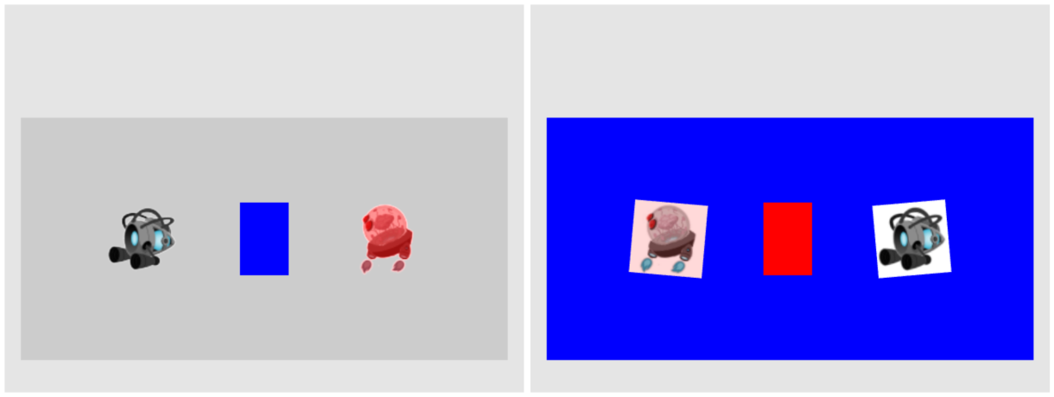
5.1: TextureShader Project

Slide 25
5.1: Goals
define uv coordinates for geometries with WebGL
create a texture coordinate buffer in WebGL
build GLSL shaders to render the textured geometry
define the texture engine component to load and process an image into a texture and to unload a texture
implement simple texture tinting, a modification of all texels with a programmer-specified color

Slide 26
Texture Implementation overview
GLSL Shaders: TextureVS.glsl + TextureFS.glsl
Support UV coordinate at vertex positions
Engine_VertexBuffer.js:
Define UV buffer to load into WebGL
TextureShader.js:
Allow programmer access to the GLSL Shaders
Engine_DefaultResources:
New instance of sharable TextureShader object
TextureRenderable.js:
Allows multiple textureShader objects to be drawn (at different locations)
Engine_Textures.js:
Allows loading of texture files

Slide 27
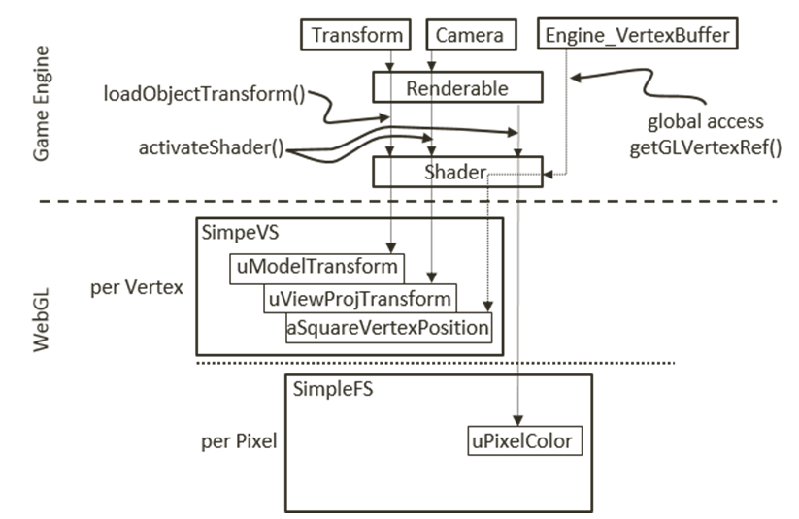
Review: SimpleShader and GLSL Shaders
attribute: aSquareVertexPosition
Per vertex change
Fed via gl.ARRAY_BUFFER
uniform: transforms and pixelColor
Per render update
Stay constant for all vertices
SimpleShader:
Interfaces JavaScript to GLSL variables
Renderable:
Supports our clients to work with SimpleShader

Slide 28
Texture Implementation overview
GLSL Shaders: TextureVS.glsl + TextureFS.glsl
Support UV coordinate at vertex positions
Engine_VertexBuffer.js:
Define UV buffer to load into WebGL
TextureShader.js:
Allow programmer access to the GLSL Shaders
Engine_DefaultResources:
New instance of sharable TextureShader object
TextureRenderable.js:
Allows multiple textureShader objects to be drawn (at different locations)
Engine_Textures.js:
Allows loading of texture files

Slide 29
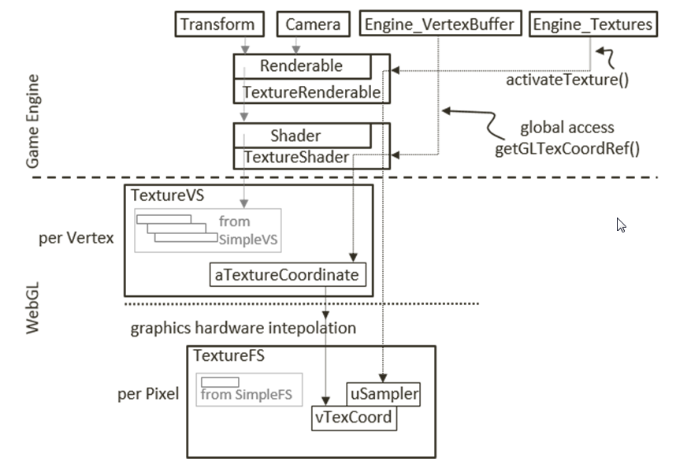
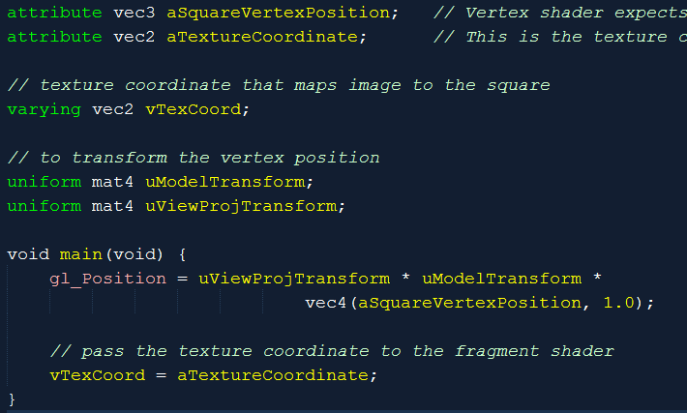
TextureVS (Vertex Shader)
varying: changes per pixel
Feeds into Fragment Shader
aTextureCoordinate:
from Engine_VertexBuffer (later)

Slide 30
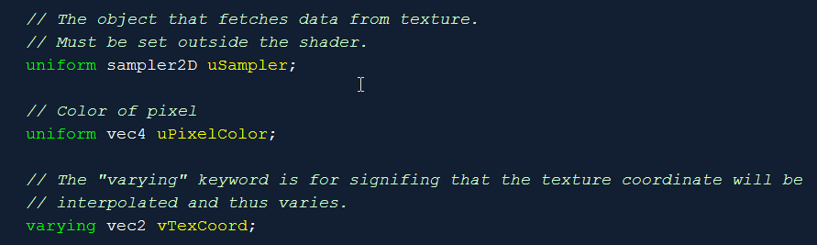
TextureFS (Fragment Shader): Variables
Note the varying (vTexCoord)
Same name as in TextureVS!
sampler2D datatype!

Slide 31
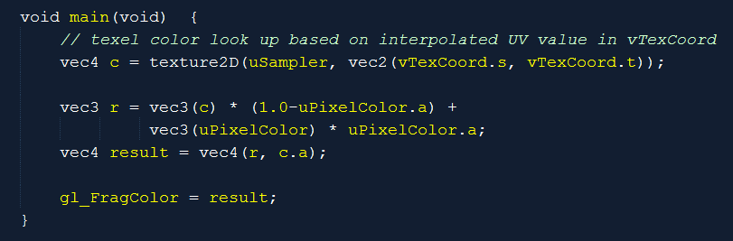
TextureFS (Fragment Shader): code
Note the texture2D() GLSL function
Using of vTexCoord!
(s, t): interpolated (u, v)
What does r compute?

Slide 32
Texture Implementation overview
GLSL Shaders: TextureVS.glsl + TextureFS.glsl
Support UV coordinate at vertex positions
Engine_VertexBuffer.js:
Define UV buffer to load into WebGL
TextureShader.js:
Allow programmer access to the GLSL Shaders
Engine_DefaultResources:
New instance of sharable TextureShader object
TextureRenderable.js:
Allows multiple textureShader objects to be drawn (at different locations)
Engine_Textures.js:
Allows loading of texture files

Slide 33
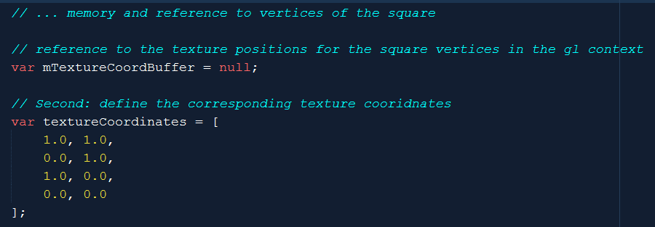
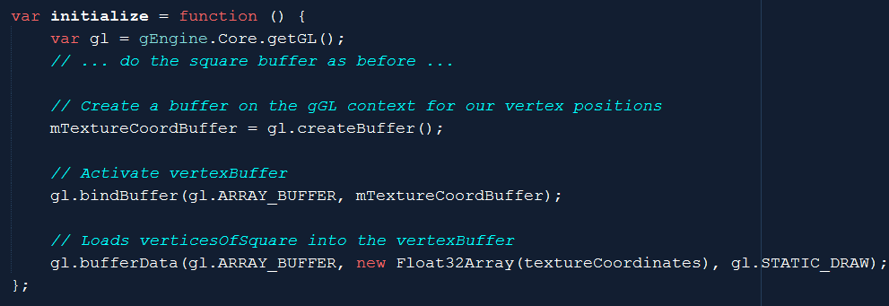
VertexBuffer support for UV Coordinate
Engine_VertexBuffer.js

Slide 34
Texture Implementation overview
GLSL Shaders: TextureVS.glsl + TextureFS.glsl
Support UV coordinate at vertex positions
Engine_VertexBuffer.js:
Define UV buffer to load into WebGL
TextureShader.js:
Allow programmer access to the GLSL Shaders
Engine_DefaultResources:
New instance of sharable TextureShader object
TextureRenderable.js:
Allows multiple textureShader objects to be drawn (at different locations)
Engine_Textures.js:
Allows loading of texture files

Slide 35
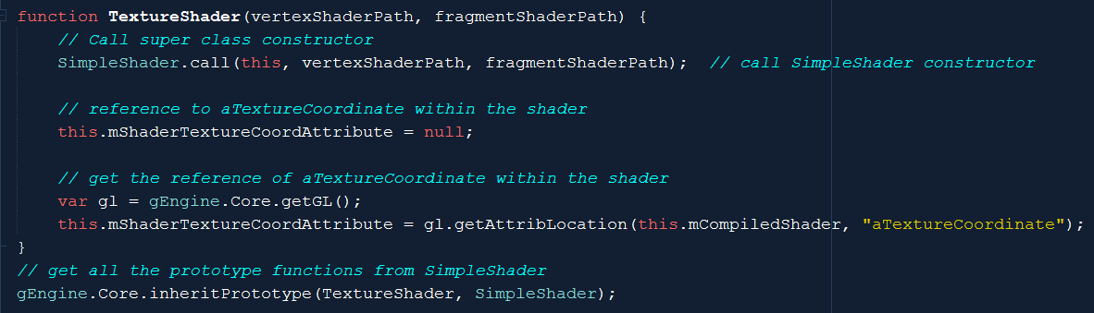
TextureShader
A SimpleShader (access to all instance var)
With new attribute reference
mShaderTextureCoordAttribute to aTextureCoordinate

Slide 36
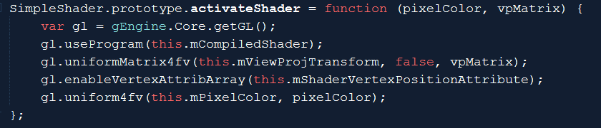
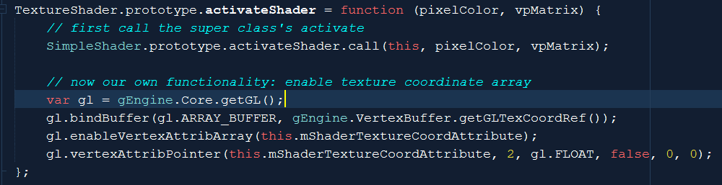
TextureShader::activateShader()
Send square vertex positions
SimpleShader::activateShader()
In addition: binds and connects texture coordinates
Binds gl.ARRAY_BUFFER to mShaderTextureCoordAttribute
To Engine_VertexBuffer::mTexCoordBuffer (getGLTexCoordRef())

Slide 37
Texture Implementation overview
GLSL Shaders: TextureVS.glsl + TextureFS.glsl
Support UV coordinate at vertex positions
Engine_VertexBuffer.js:
Define UV buffer to load into WebGL
TextureShader.js:
Allow programmer access to the GLSL Shaders
Engine_DefaultResources:
New instance of sharable TextureShader object
TextureRenderable.js:
Allows multiple textureShader objects to be drawn (at different locations)
Engine_Textures.js:
Allows loading of texture files

Slide 38
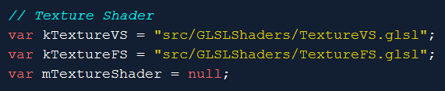
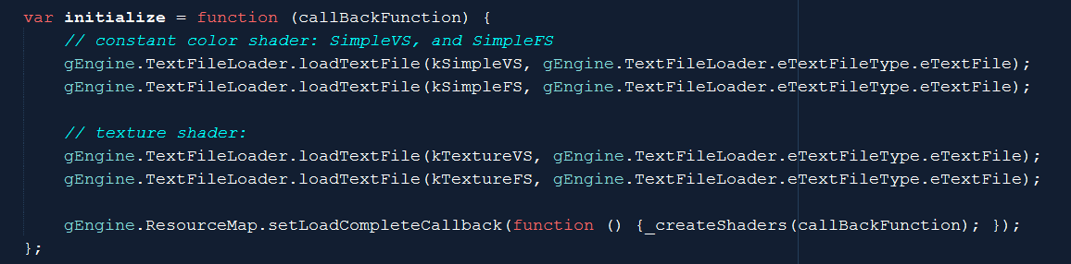
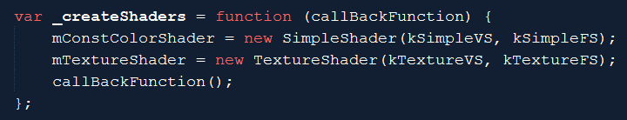
gEngine_DefaultResources: Enable sharing
Engine_DefaultResources.js

Slide 39
Texture Implementation overview
GLSL Shaders: TextureVS.glsl + TextureFS.glsl
Support UV coordinate at vertex positions
Engine_VertexBuffer.js:
Define UV buffer to load into WebGL
TextureShader.js:
Allow programmer access to the GLSL Shaders
Engine_DefaultResources:
New instance of sharable TextureShader object
TextureRenderable.js:
Allows multiple textureShader objects to be drawn (at different locations)
Engine_Textures.js:
Allows loading of texture files

Slide 40
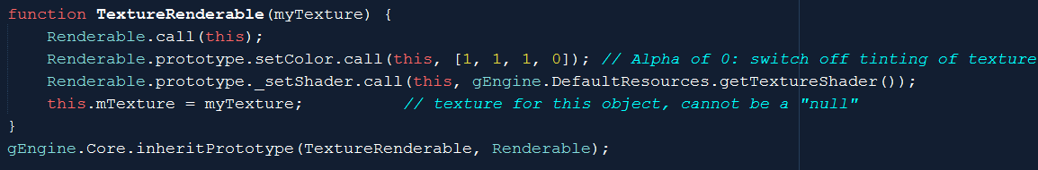
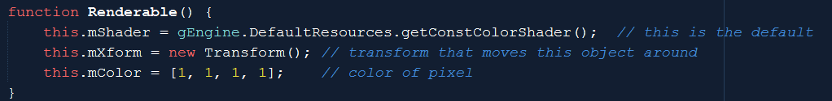
TextureRenderable: Controllable game objects
A Renderable object with
reference to TextureShader and
A loaded texture map

Slide 41
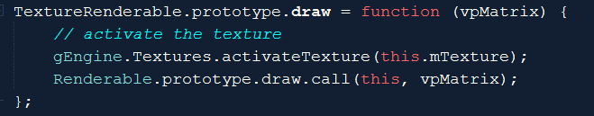
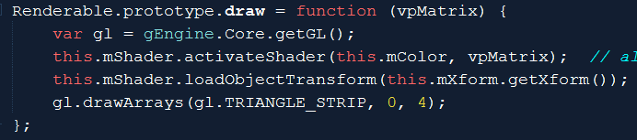
TextureRenderable: draw()
Textures.activateTexture(): [to come]
Activates and connects
uSampler in TextureFS to current texture image
Renderable.draw():
SimpleShader::activateShader()
Connects and loads square vertex
TextureShader::activateShader()
Connects and loads UV coordinate
TextureFS.glsl
Renderable.js

Slide 42
Texture Implementation overview
GLSL Shaders: TextureVS.glsl + TextureFS.glsl
Support UV coordinate at vertex positions
Engine_VertexBuffer.js:
Define UV buffer to load into WebGL
TextureShader.js:
Allow programmer access to the GLSL Shaders
Engine_DefaultResources:
New instance of sharable TextureShader object
TextureRenderable.js:
Allows multiple textureShader objects to be drawn (at different locations)
Engine_Textures.js:
Allows loading of texture files

Slide 43
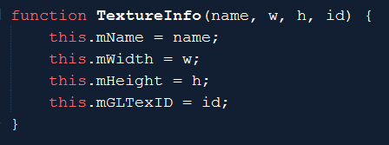
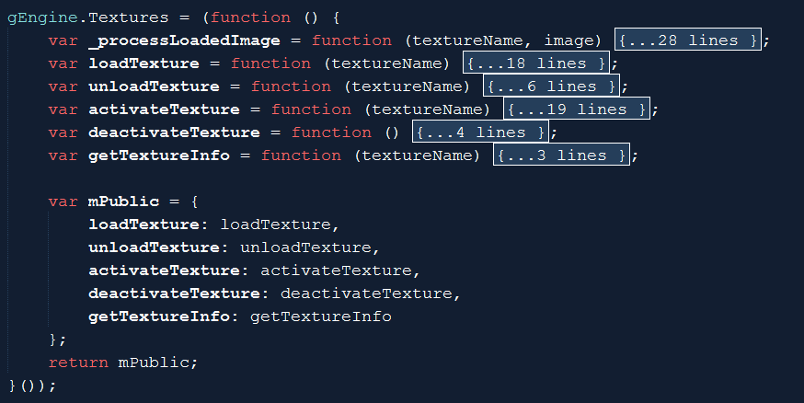
Engine Texture component
TextureInfo object: for ResourceMap
Engine_Textures.js

Slide 44
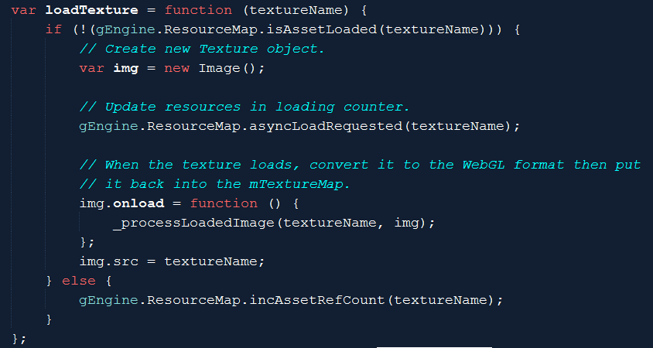
Engine_Texture::loadTexture()
Work with ResourceMap like previous async loads
calls _processLoadedImage() when ready

Slide 45
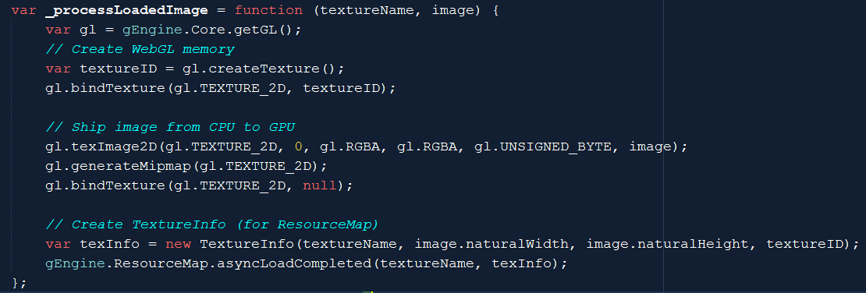
Engine_Texture::_processLoadedImage()
Ship loaded image from CPU to GPU
Create TextureInfo object for ResrouceMap to keep track (textureID)

Slide 46
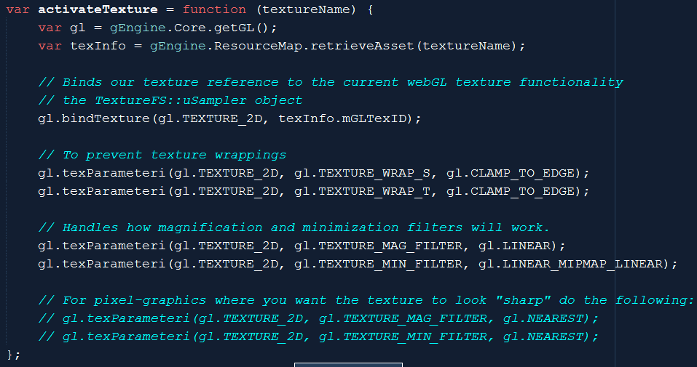
Engine_Texture::activateTexture()
ResourceMap:: stores TextureInfo!!
Binds textureInfo.mGLTexID to uSampler in TextureFS.glsl
Texture Wrapping and Filtering

Slide 47
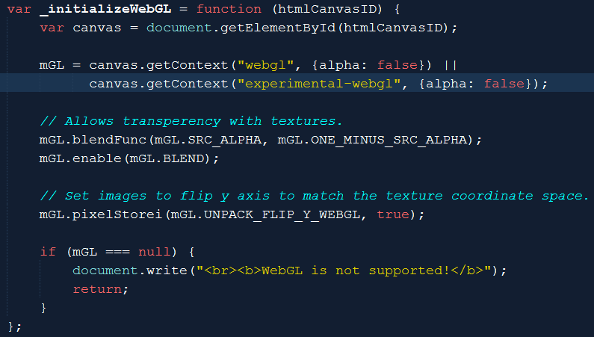
Engine configuration changes
Engine_Core.js
Canvas: opaque
Blending support in TextureFS.glsl!
C1*A + C2*(1 – A)
Texture Map y increases upwards

Slide 48
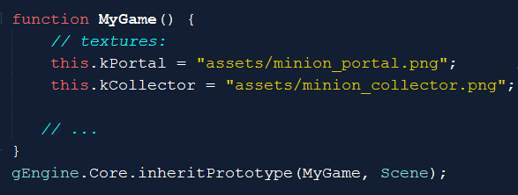
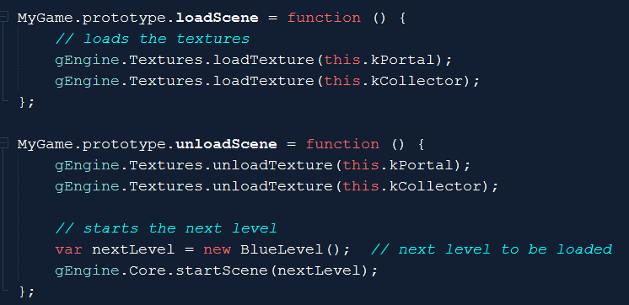


Testing Texture map …
Define and load textures

Slide 49
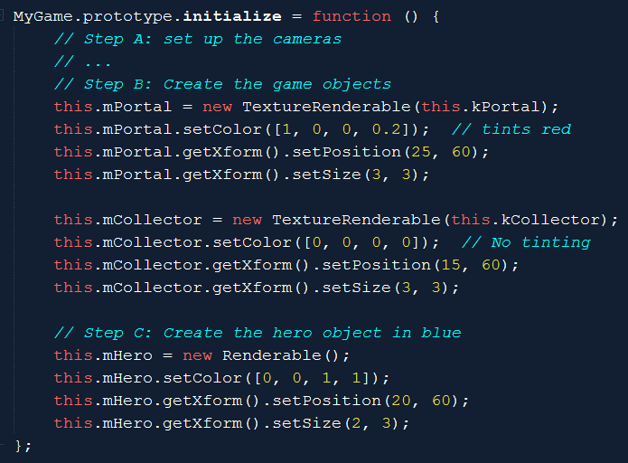
Creating texture objects (TextureRenderable)
Color’s Alpha values
Remember the “r”
In TextureFS?
Texture tinting
TextureFS.glsl

Slide 50
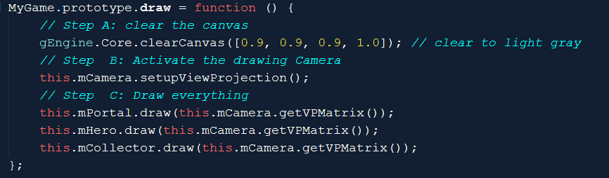
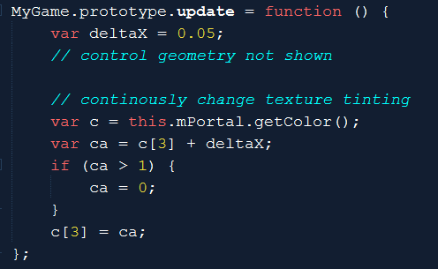
Drawing/Updating with texture
Draw as before
Update tint …
C[3] is alpha

Slide 51
Texture Implementation overview
GLSL Shaders: TextureVS.glsl + TextureFS.glsl
Support UV coordinate at vertex positions
Engine_VertexBuffer.js:
Define UV buffer to load into WebGL
TextureShader.js:
Allow programmer access to the GLSL Shaders
Engine_DefaultResources:
New instance of sharable TextureShader object
TextureRenderable.js:
Allows multiple textureShader objects to be drawn (at different locations)
Engine_Textures.js:
Allows loading of texture files

Slide 52
Learning from Example 5.1
Texture Mapping: UV to texel mapping
Associate vertex positions and UV coordinates
GLSL varying variable type [compare with attribute and uniform]
Implement: create and associate a second buffer in WebGL
Images are loaded as textures into WebGL
ResoruceMap reference to TextureInfo (defined in Engine_Textures.js)
CPU only has a textureID
GPU stores the actual texture
Binds TextureID to uSampler in TextureFS
Engine_Textures::activateTexture()

Slide 53
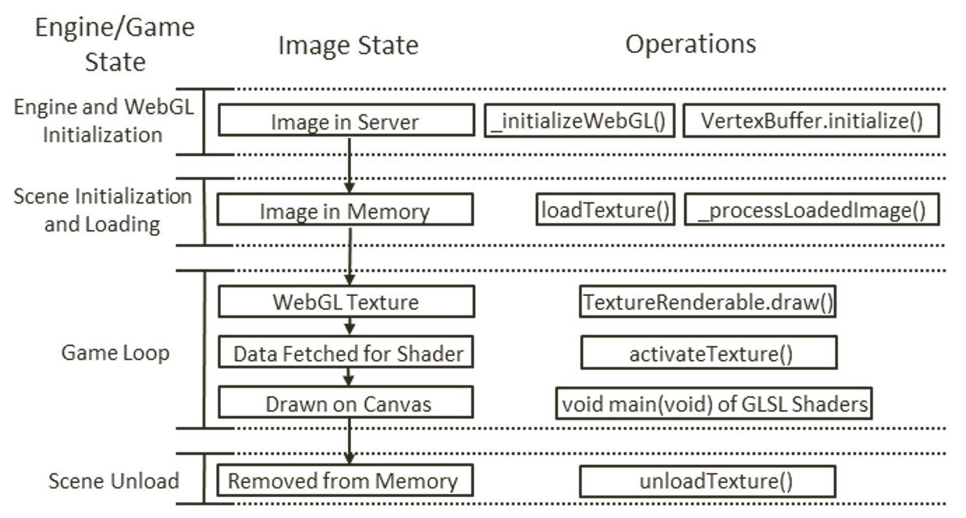
Image File, State, and WebGL

Slide 54
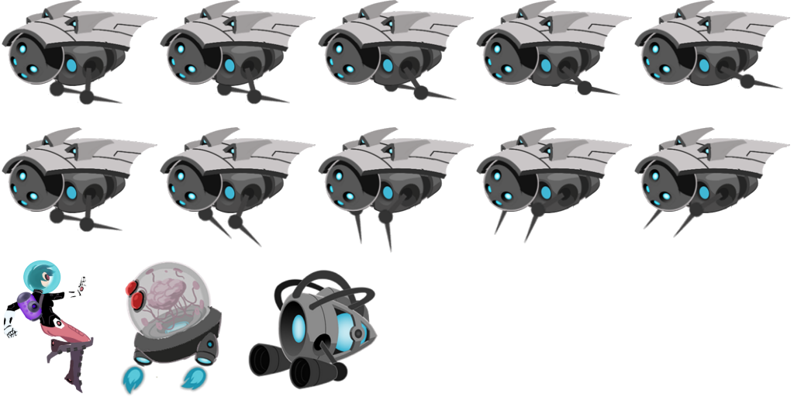

Sprite Sheets: Collection of object images
2^{n} x 2^{m} can be overly restrictive
E.g, 260x130: stored in 512x256!
Optimize load time
Loading many 16x16 images vs
Loading single 128x128 image
Organization: all objects in a level
A single 1Kx1K file
50 files of 128x128

Slide 55
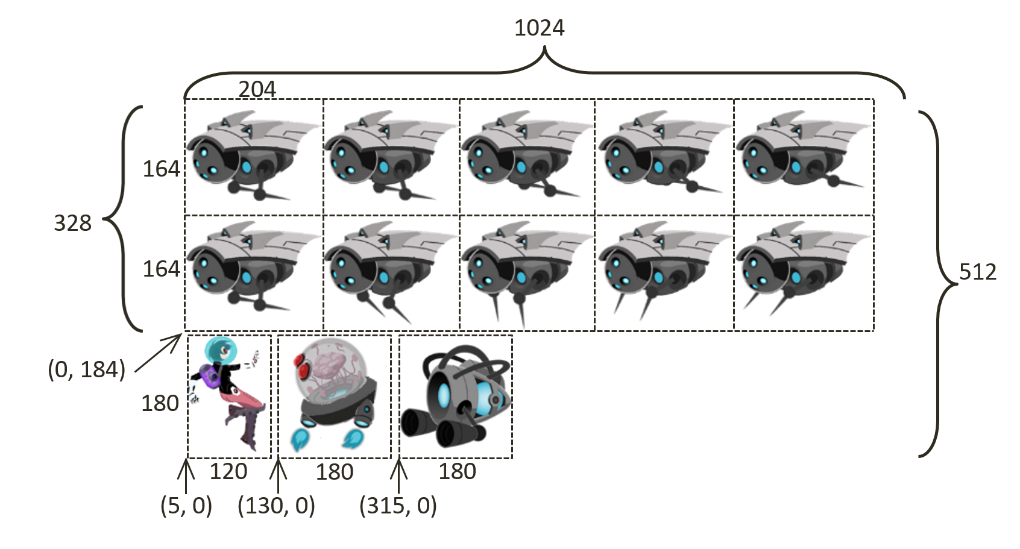
Sprite Sheet:
Artists create, communicate to developers

Slide 56
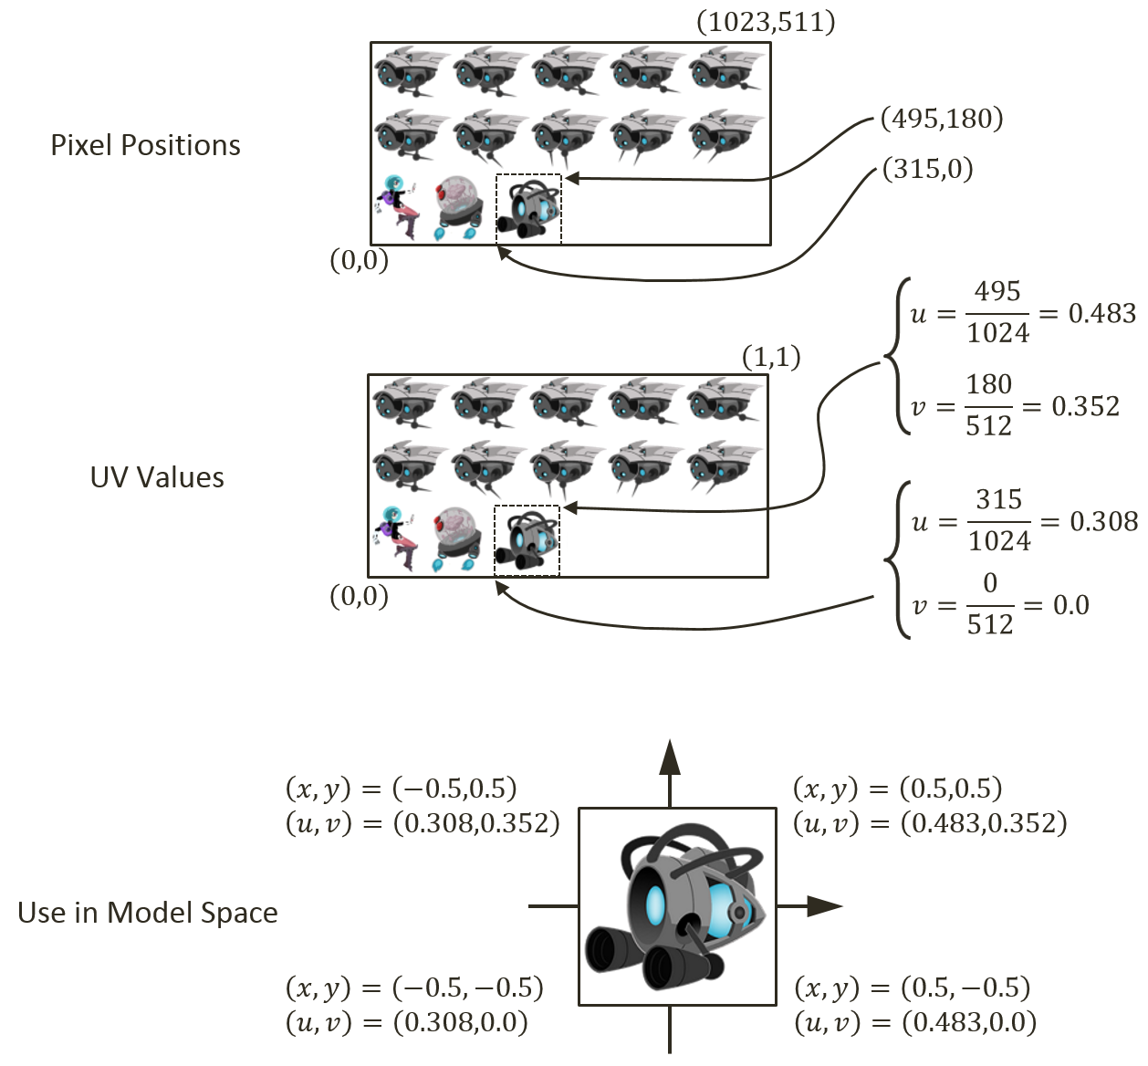
Drawing with Sprite Sheets
Figure out texel positions of an object
Portal as example
Receive info from artists
Compute UV values of the object
Recall 0 to 1 covers the entire image
Map UV values to vertex positions

Slide 57
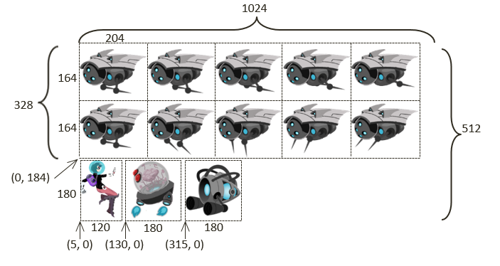
Questions:
What is the bound
[Left, Right, Bottom, Up]
for the element in the RED region
In UV values
In Pixel vales
If the RED region is moved over to the YELLOW region such that the upper-left is located at the center of the element it touches, what is the bound in UV and in pixel?
RED
YELLOW

Slide 58
Answer:
RED:
Pixel:
LEFT = 204+204 = 408
RIGHT = 204+204+204 = 612
BOTTOM = 0 + 180 + 4 = 184
TOP = BOTTOM + 164 = 184 + 164 = 348
UV:
Left = 408/1024
Right = 612/1024
Bottom = 184/512
Top = 348/512
RED
YELLOW

Slide 59
Answer:
YELLOW:
Width = 204 pixels or
(204/1024 in UV)
Height = 164 pixels or
(164/512 in UV)
Left = middle of first element = 204/2 = 102 pixel
Right = Left + 204
Bottom = 184 + (164/2) = 184 + 82 = 266 pixel
Top = Bottom + 164
RED
YELLOW

Slide 60
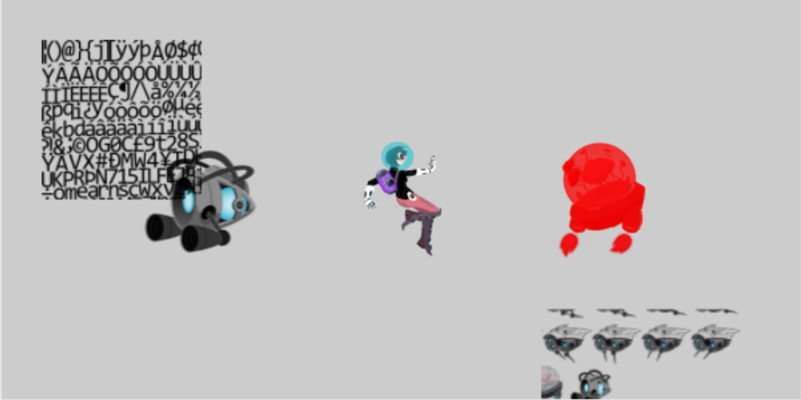
5.2: Sprite Shaders Project

Slide 61
5.2 Goals:
gain understanding for texture coordinate (UV)
experience defining sub-regions within an image for texture mapping
draw squares by mapping from sprite sheet elements
prepare for working with sprite animation and bitmap fonts

Slide 62
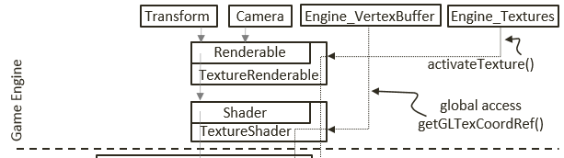
Recall: TextureShader …
Engine_VertexBuffer::
getGLTexCoordRef()
Refers to a static WebGL Buffer
Defined once, shared by all TextureShaders!
UV values in the buffer are bounds of UV space and cannot be changed!
Need per-shader Texture coordinate UV buffer for Sprite support
Engine_VertexBuffer.js

Slide 63
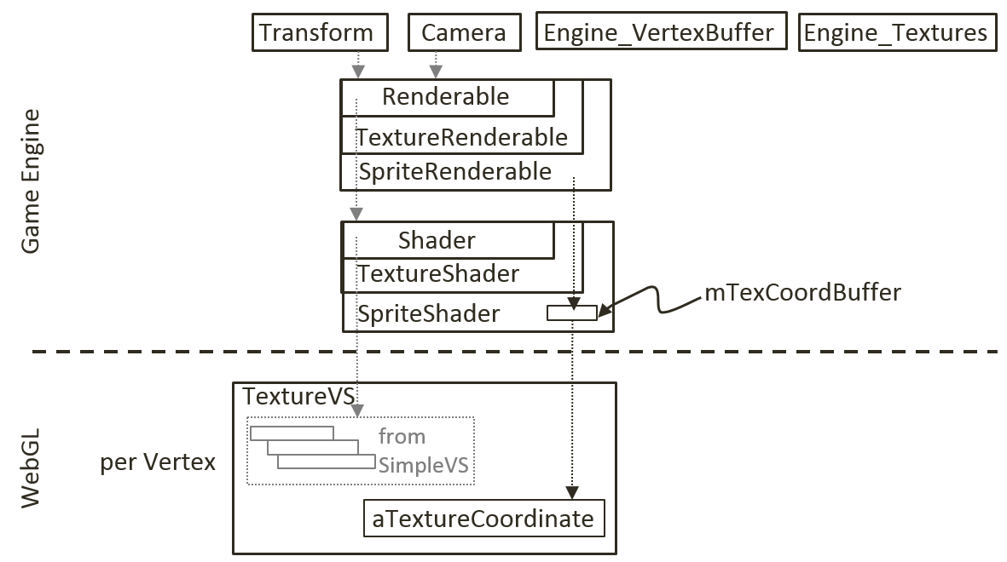
SpriteShader:
A TextureShader which defines its own Texture Coordinate Buffer!

Slide 64
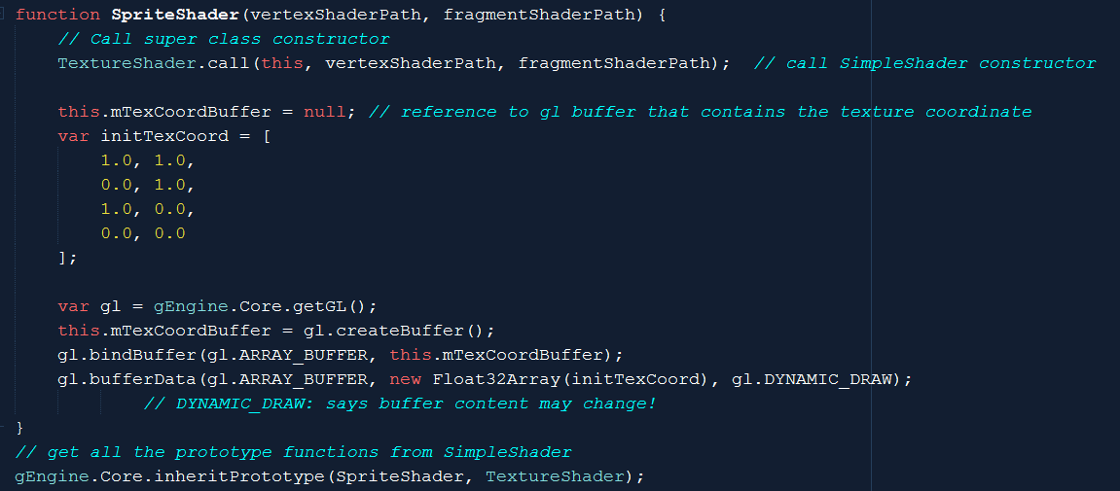
SpriteShader
Defines and loads a Dynamic texture coordinate buffer!

Slide 65
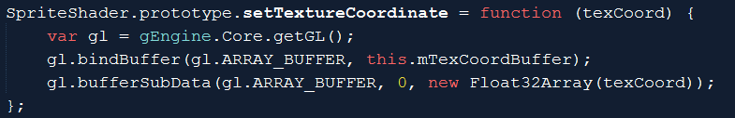
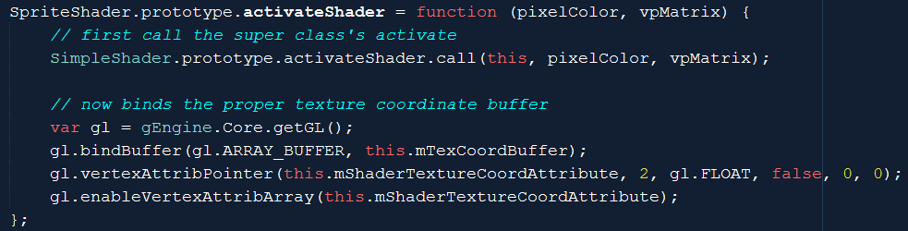
SpriteShader: custom texture coordinate
Set texture coordinate (into WebGL)!
bufferSubData(): pushes array to WebGL!
Draw with its own texture coordinate buffer
Call to SimpleShader::activateShader (not TextureShader!)

Slide 66
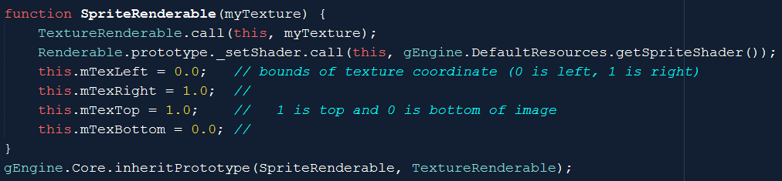
SpriteRenderable:
A TextureRenderable which remembers UV values for each vertices (instead of the default UV bounds)
DefualtResources: creates a default SpriteShader

Slide 67
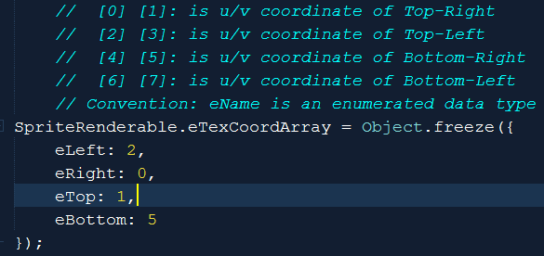
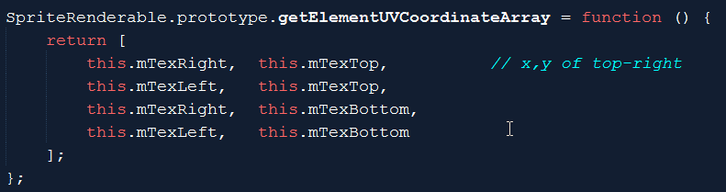
SpriteRenderable: UV to WebGL format

Slide 68
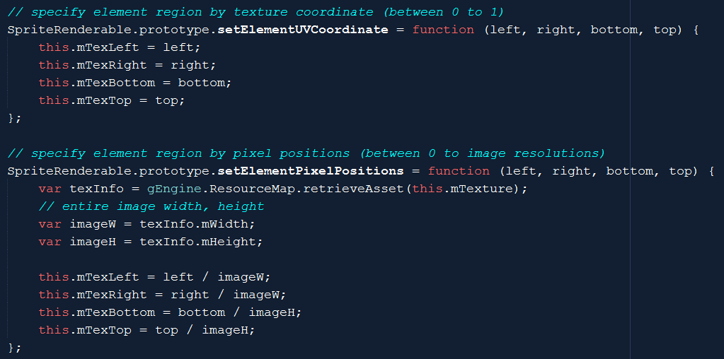
SpriteRenderable: UV setting functions
In UV
In pixel values (must convert to UV)
Notice: image resolution from ResourceMap (TextureInfo)

Slide 69
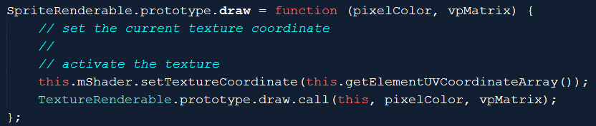
SpriteRenderable: draw
Calls SpriteShader::setTextureCooridnate()
Loads UV to WebGL!
SpriteRenderable.js
SpriteShader.js

Slide 70
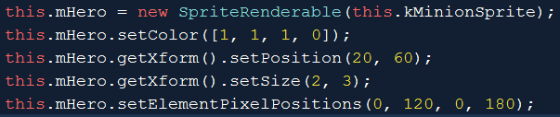
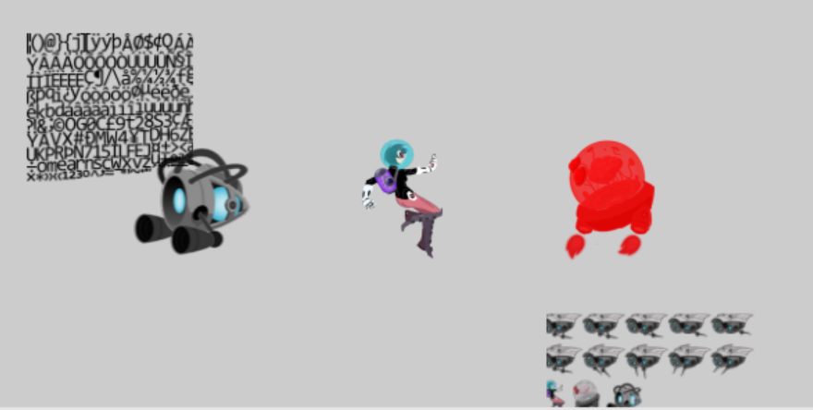


Testing SpriteRenderable
Same TextureMap!!
TextureMap is shared
SpriteShader is shared
Unique SpriteRenderables!

Slide 71


Changing UV in Update

Slide 72


Sprite Animations
Strategically drawn Sprite Sheets
Sequence through elements strategically
Similar to stop-frame animations
Explicit communications with creating artists are required to decode

Slide 73

Organization Conventions
Not “laws,” something people seem to follow
Rows x Columns:
Fixed size on a sheet m-pixels by n-pixels
Paddings around each elements
Single row (or part of a row) defines action
Almost never cross rows

Slide 74



Parameters of Sprite Animation
Direction:
Forward (Left towards right)
Backward (Right towards left)
Swing
Speed: rate at which to change

Slide 75

5.3: Sprite Animation Project

Slide 76
5.3: Goals
gain understanding of animated sprite sheets
experience the creation of sprite animations
define abstractions for implementing sprite animations

Slide 77
Implementation consideration
New shader?
NO!!
Access/update SpriteShader’s
mTexCoordBuffer
Change per animation update!

Slide 78
SpriteAnimateRenderable:
Define animation type/speed
Support defining and moving of sprite elements UV-area

Slide 79

SpriteAnimateRenderable: constructor

Slide 80
SpriteAnimateRenderable: constructor
Using SpriteShader!!
no need for anything new from the shader!

Slide 81
SpriteAnimateRenderable: constructor

Slide 82
SpriteAnimateRenderable: constructor
UV-area for first sprite element
AND
Padding information (so that it is possible to advance)
Number of sprite elements in the animation

Slide 83
SpriteAnimateRenderable: constructor

Slide 84

SpriteAnimateRenderable: constructor
Animation characteristics
Type: Left-ward, Right-ward, or Swing
How fast is the animation (unit in “update()” calls! Or 1/60 second)

Slide 85
SpriteAnimateRenderable: constructor

Slide 86

SpriteAnimateRenderable: constructor
Animation-time state variables

Slide 87


SpriteAnimateRenderable: utilities

Slide 88

SpriteAnimateRenderable: utilities
Defines a sequence
In pixel space
Notice, must convert to UV

Slide 89


SpriteAnimateRenderable: animate!
Update reference
Re-computes UV
Sends new UV

Slide 90

Testing Sprite Animation
To create

Slide 91

Testing Sprite Animation
To change and update (in MyGame.js::update())
NOTE: must call obj.updateAnimation() to see animation!

Slide 92

Fonts
Can be important in games
Especially for debug output
Pain to support
Hack: Bitmap fonts
Image + Instruction (to decode)

Slide 93

5.4: Font Support

Slide 94
5.4: Goal
Drawing text is not as interesting as the problem at hand
Designing a text solution based on what we have
Given a “string”:
find UV for first character from the bitmap font image
Set the sprite element UV values of a SpriteRenderable
draw the SpriteRenderable: one character
Compute space to skip
Repeat for next character
Abstract the above: FontRenderable

Slide 95
Procedure of working with fonts
Similar to _ALL_ external resources
Load:
DefaultResources: default system font
Per game scene font (if you have any)
Create a Renderable to draw with it
Slightly different …

Slide 96

FontRenderable:
NOT a subclass or Renderable
Instead: has an instance of SpriteRenderable: mOneChar
mText: is the string we want to draw
Note:
FontRenderable: has a transform (this.mXform)
mOneChar: has a separate transform!!

Slide 97

FontRenderable::draw()

Slide 98
FontRenderable::draw()
xPos: x Position of the first character
yPos: y position of _all_ of the characters
Limitation!: Cannot span more than one line!

Slide 99
FontRenderable::draw()

Slide 100
FontRenderable::draw()
For each character
Compute the xform of the character (mOneChar.xForm)
Draw the character
Limitation: String is not an entity (e.g., cannot rotate the string)!

Slide 101
Font rotation
In FontRenderable.draw()
Must pass rotation
from FontRenderable.mXform
to mOneChar.mXform

Slide 102
Chapter 5: learned?
Use resource manager
Texture mapping
UV Coordinate System
Sprite elements in a Texture
Drawing with sprites
Sprite Sheet for animation
Sprite Animation
Bitmap font
Next: Simple behavior (collision)!

